Slide 1
Why Python or a Brief History of Computer Languages.

Slide 2
How Does a Programming Language Work

Slide 3
How Does a Computer Work?

Slide 4


Von Neumann Architecture
Computer
Control Unit
Ok, but how is this executed exactly?
Central Processing Unit (CPU)
Clock
Input Device
Output Device
Arithmetic/Logic Unit
Memory

Slide 5
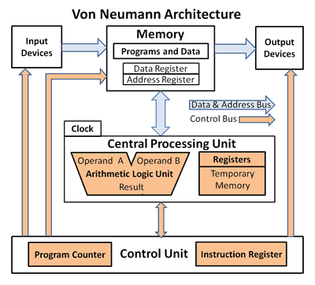

Slide 6
The Pioneers (Pre-Vacuume Tube Age ~1800s - 1907)

Slide 7
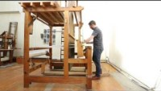
1804 – Joseph Marie Jacquard
The Jacquard loom
Used Punch Cards system to recreate complex patterns on a loom.

Slide 8
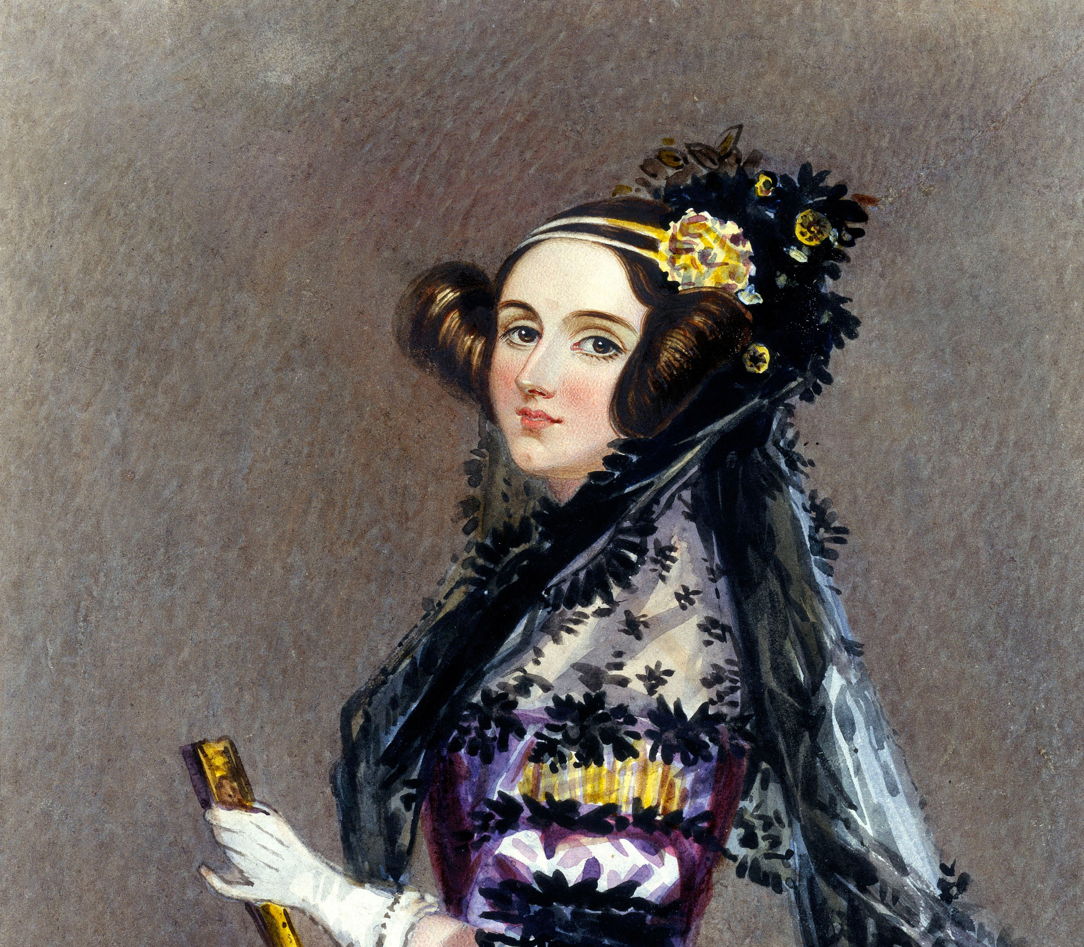
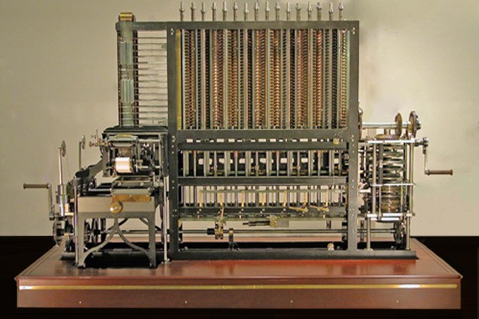
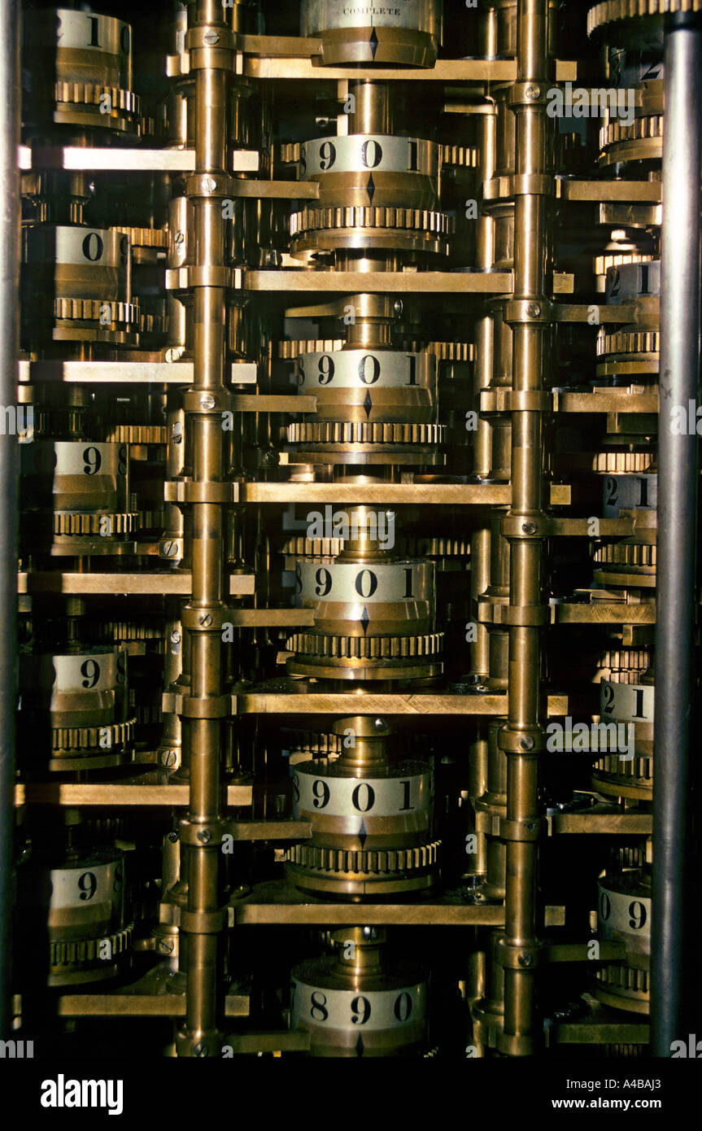
1883 – Ada Lovelace
First Programming Language to Calculate Bernoulli numbers
Created for a Victorian Steam Powered Calculator
A Primitive Computer

Slide 9
1886 – Boolean Logic & Logic Gates
First Programming Language to Calculate Bernoulli numbers
Created for a Victorian Steam Powered Calculator
A Primitive Computer

Slide 14
Check out the Still (light blue) bullets
These Still colored (light blue) bullets replace the Highlight bullets
These bullets now pass the accessibility requirements per our Brand Guidelines

Slide 15
This slide no longer contains our highlight color
This color has been changed to still (light blue)
These Still colored (light blue) bullets replace the Highlight bullets
These bullets now pass the accessibility requirements per our Brand Guidelines

Slide 18

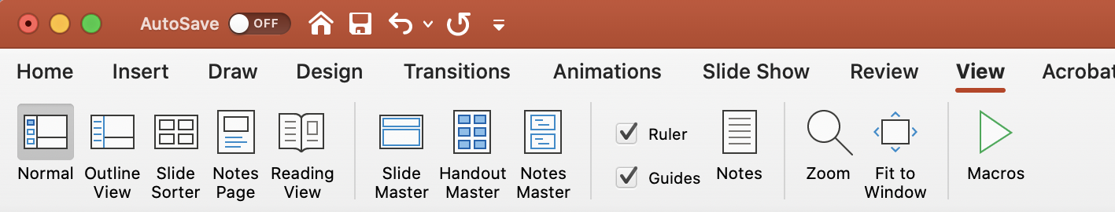
Margins and footers
Ensure footers are relevant and consistent. Always include a footer.
Stay within the margins. Find the margins in the View menu and click on Guides.

Slide 19
Example of graphs

Slide 20
Example of graphs

Slide 21
Example of chart
Head
Section A
Section B
Section C
1
2
3
1
2
3
1
2
3

Slide 22






























Popular icons — view full library for more
360°
Consolidate
Award
Barcode
Brain
Briefcase
Governance
Data
Delivery
Digital Transformation
New Document
Employee
Personalization
Gear
Handshake
Analyze
Hierarchy
Location
Messages
Customer
Dashboard
Server
Retail
Shopping Cart
Handcart
Arrows
Tag
Bullseye
Thumbs Up
Warehouse

Slide 23












Product icons — view full library for more

Slide 24
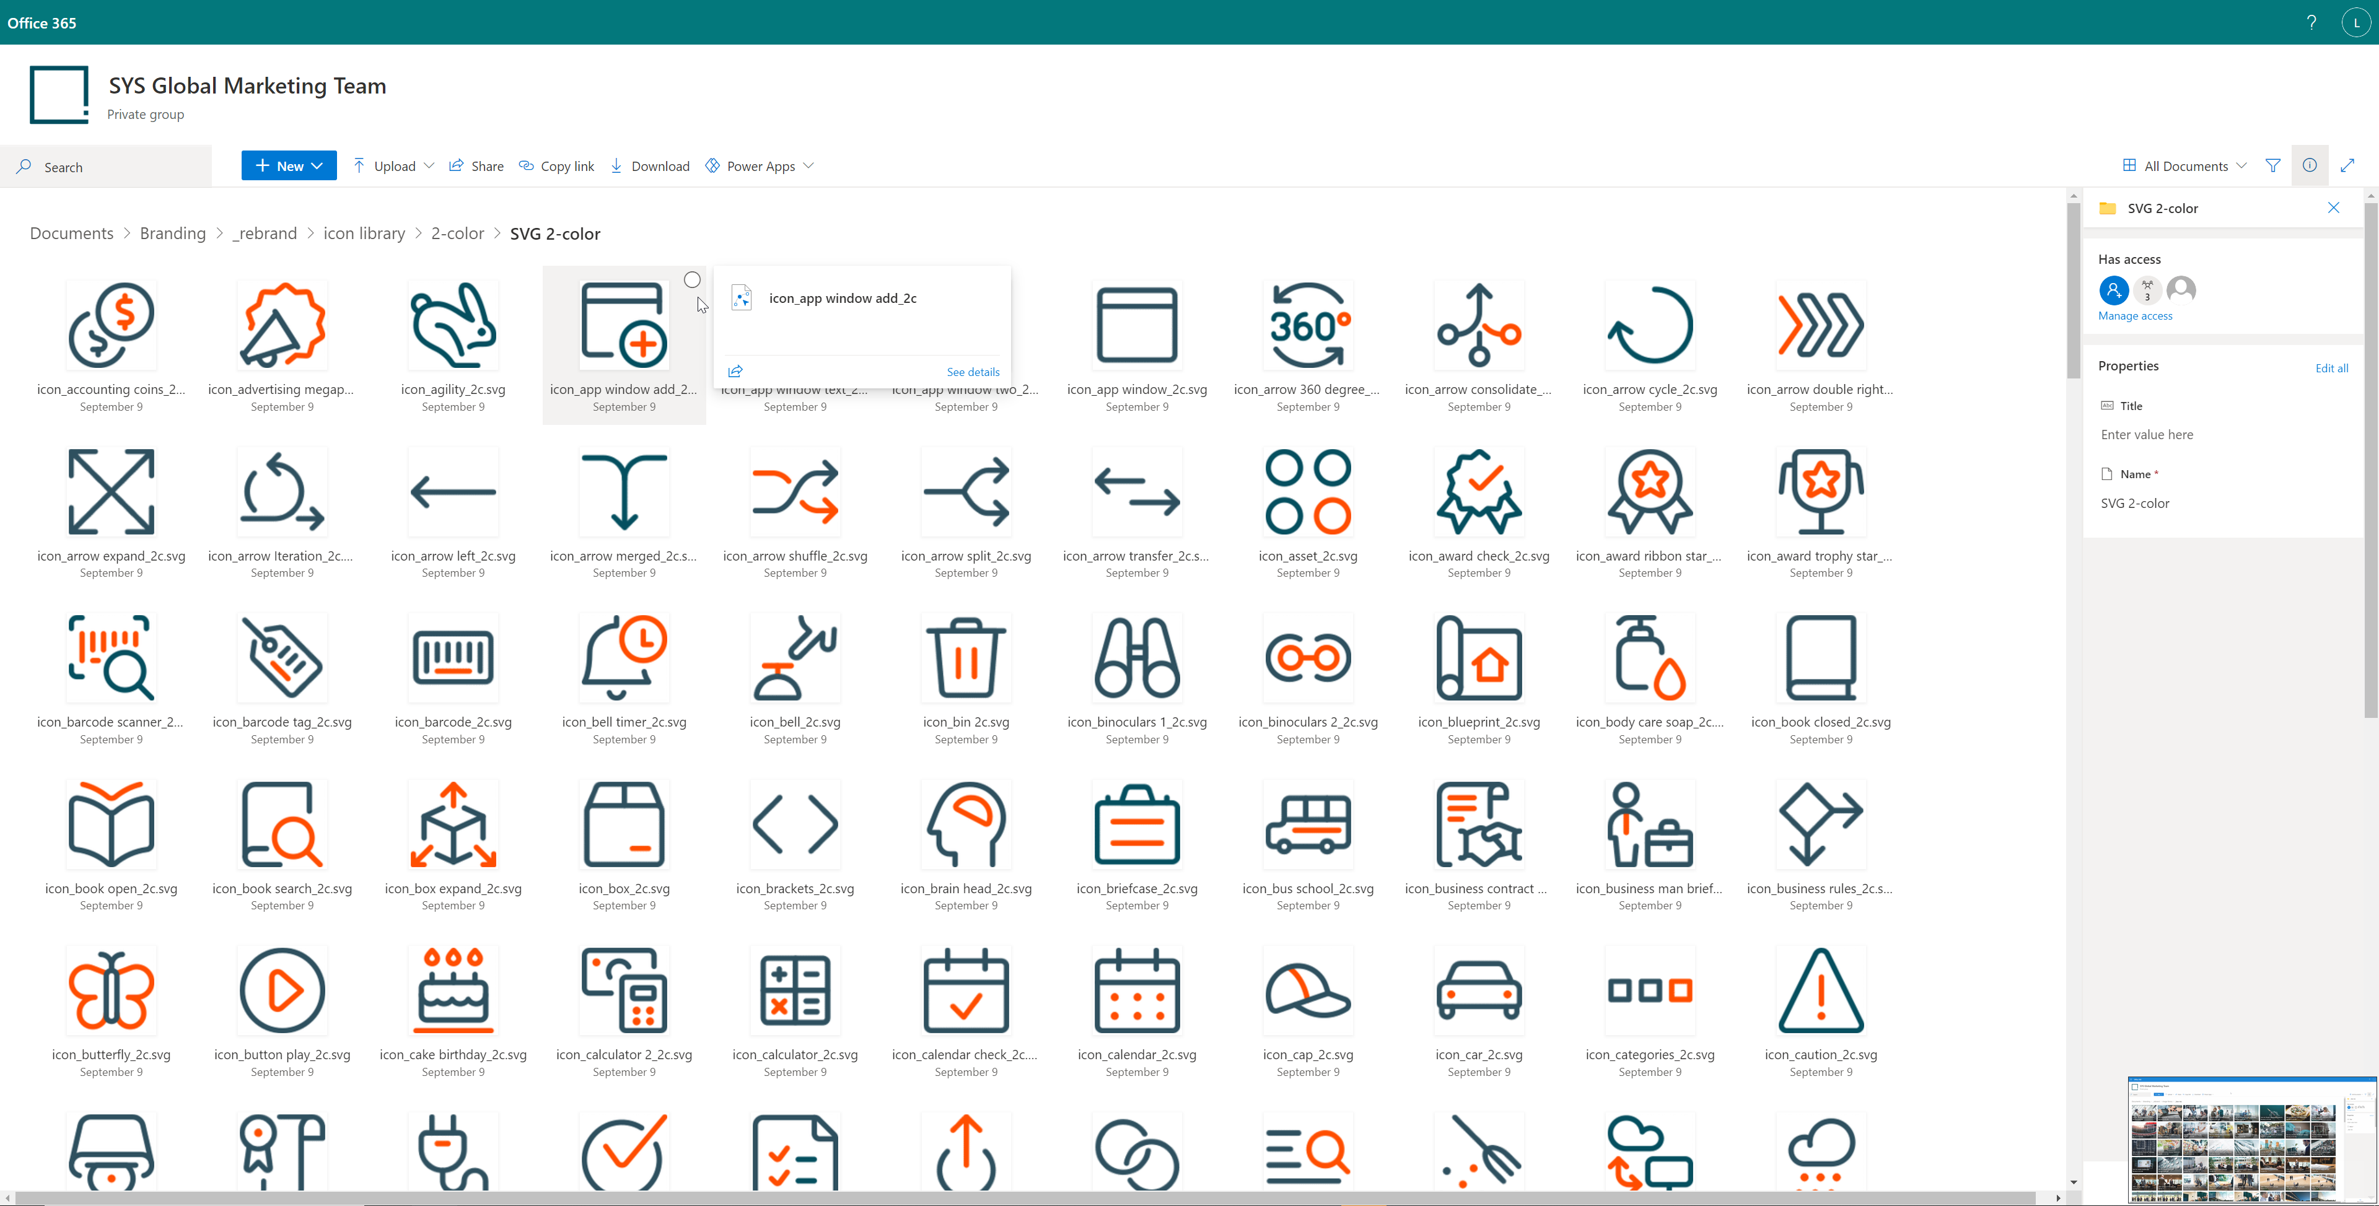
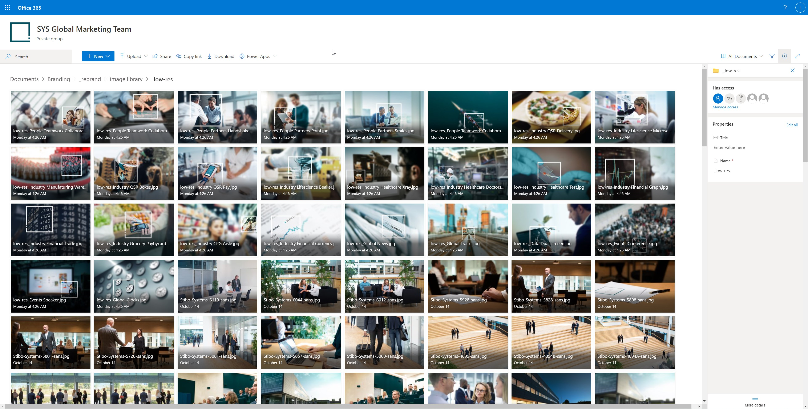
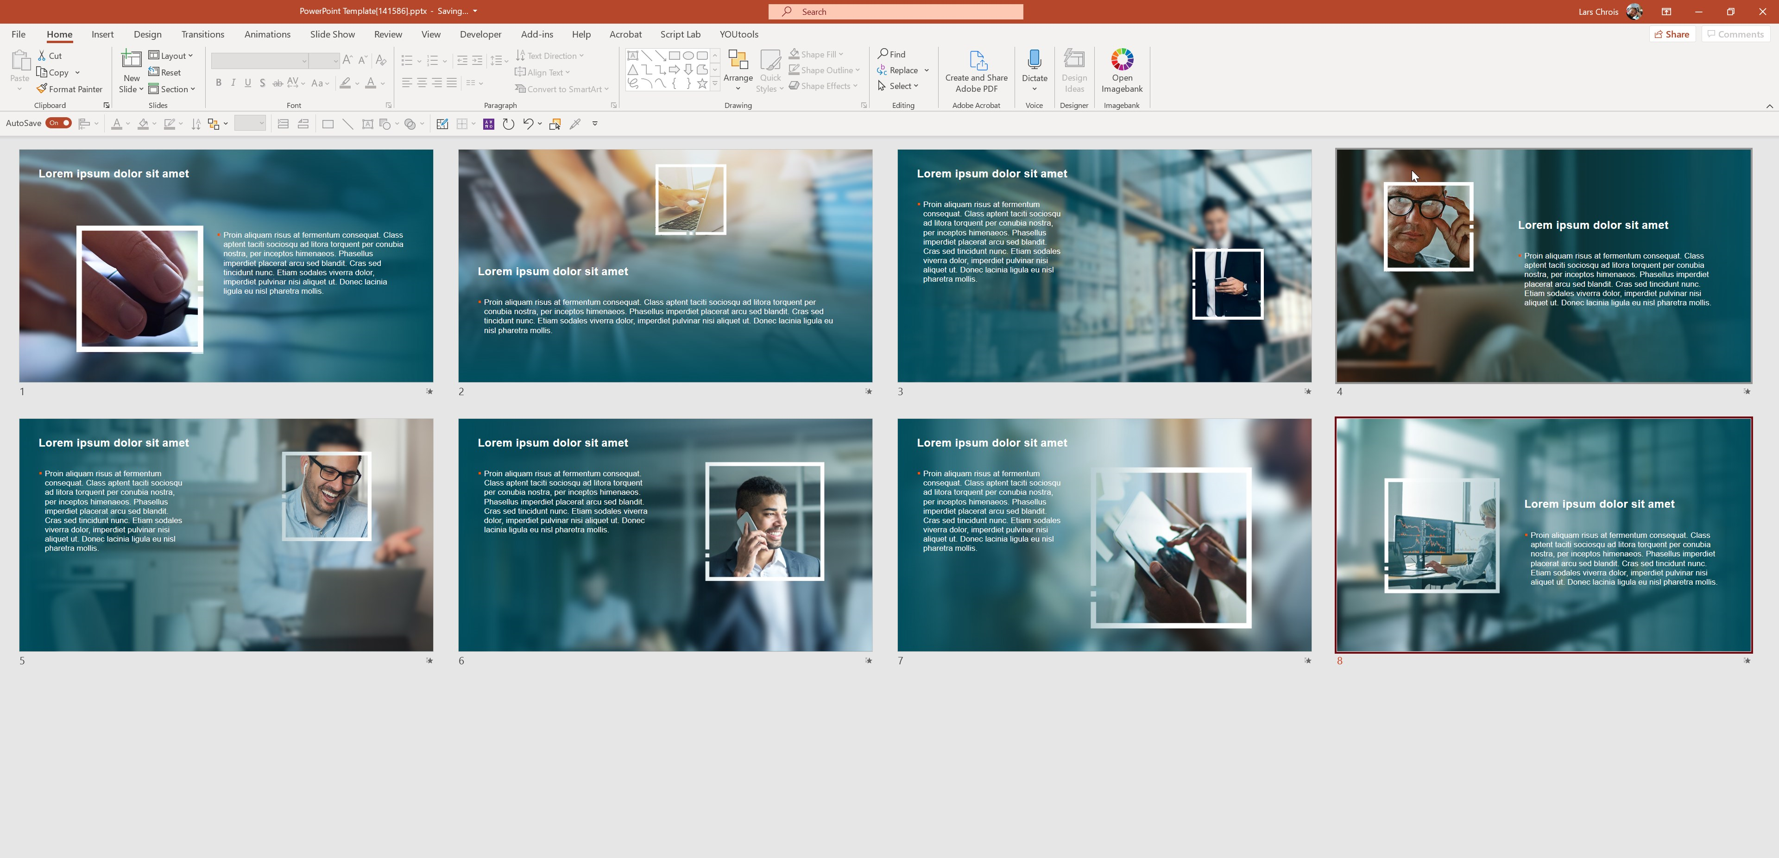
Images, icons and WoT slides
Asset library
Follow the link to access the icon library
Follow the link to access the image library
Follow the link to access the Window of Transparency slides

Slide 25
Textboxes and arrows
Toolbox
XX%
Text explaining the impressive number. We can get into some details!
A box with fill
use with less text
Detailed box
With a 14 point size we can write a lot but take care in visual presentations as this will derail your audience and they will read on instead of listening.
White box – works well for placement on a colored background
Orange border
Blue border
Background Grey

